Slide 1

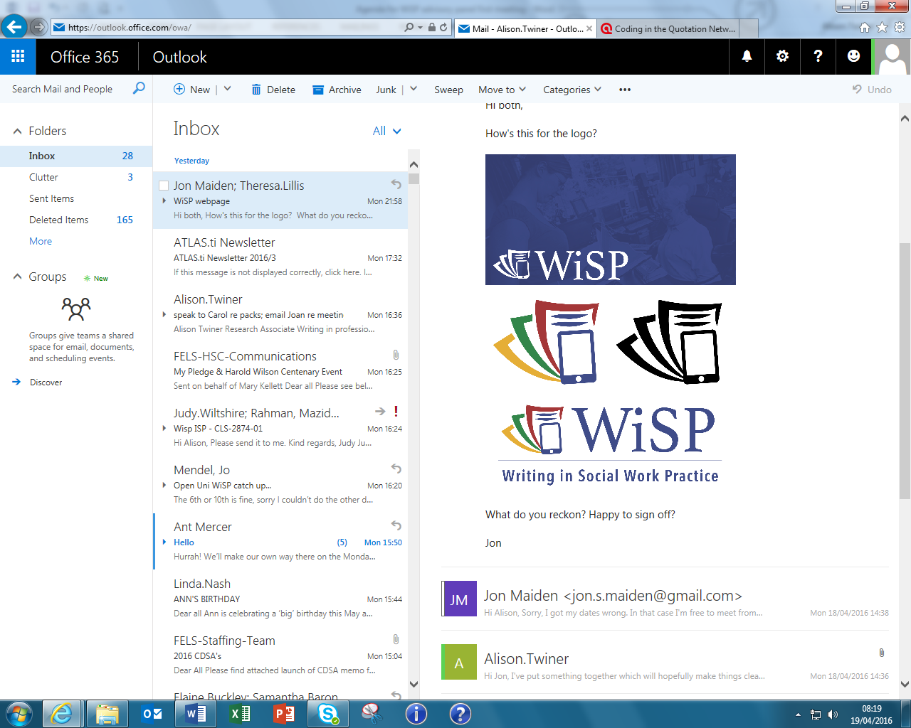

Combining ethnography and corpus to research writing practices in social work: challenges and opportunities in methodology, epistemology and application
Presentation of work in progress at Applied Linguistics and Professional Practice Conference, Copenhagen, November 2016
Theresa Lillis, Maria Leedham and Alison Twiner
The Open University, UK

Slide 2
Aims of presentation
1. To give an overview of the WiSP project
2. To outline our methodological approach
3. To illustrate/evaluate our methodology – particularly in relation to ethnography and corpus- by looking at a particular text type and practice= ‘case notes’
What does an ethnographic orientation to case notes enable us to understand?
What does a corpus linguistic orientation to case notes enable us to understand?
4. Reflecting on what it means to ‘combine’ ethnography and corpus
- Opportunities, challenges, tensions in methodology, epistemology and application

Slide 3
About WiSP
2-year, ESRC-funded research project (October 2015-October 2017)
the first national research project on writing in professional social work practice
Research Questions
What are the institutional writing demands in contemporary social work?
What are the writing practices and perspectives of professional social workers?
What are the challenges faced and solutions found?
How are writing demands and practices shaping the nature of professional social work?
Builds on writing/literacies research (e.g. Barton and Hamilton; Barton and Papen; Lillis) work based literacies research including social work (Brandt; Pare; Rai and Lillis)

Slide 4
Why is this project important?
The production and use of written texts (often referred to as paperwork, recording, inputting or documenting) is a high stakes activity in professional social work.
Writing…
plays a central role in all decisions about services for people
is used to evaluate social workers’ professional competence
is often criticised – in public reviews and media reporting of high profile cases
Yet there is little systematic research on contemporary writing/recording demands, genres and practices

Slide 5
Data collection aims
3 social work agencies
50 interviews social workers
10 weeks of researcher observation of writing in practice
1000 social worker days of writing activity logs from social workers
A corpus of 1 million words of written texts - case notes, assessments, reports, emails….
Data collected to date
3 agencies participating
39 social worker interviews
6 weeks of observations
427 days of writing activity logs in to date
2,300 texts anonymised (over 450,000 words)
Data illustrated in this presentation- focus=case notes
Two case notes in context
Sub-corpus of case notes: case notes written by 20 social workers

Slide 6
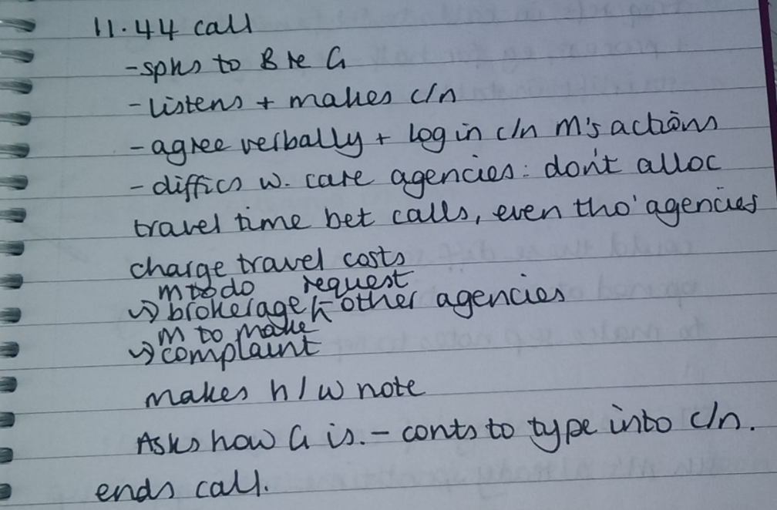

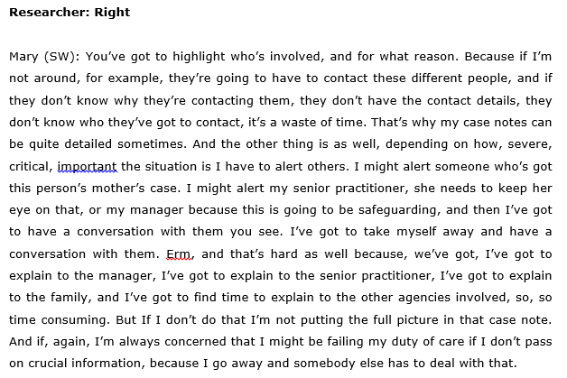
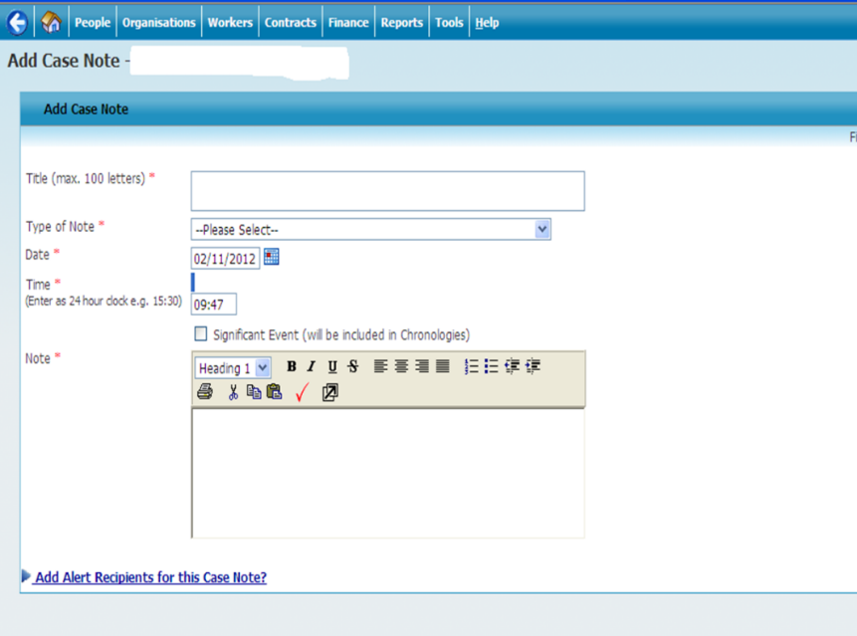

What does an ethnographic orientation to case notes enable us to understand?
Build a picture of the social work textual world through…
Observations
Interviews
Collection of texts written by social workers
Documentary data e/.g. inspection reports, guidelines, policies
We learn about…
People’s perspectives…
Amount of time spent on writing…
Types of writing…
Specific focus today- case notes; what are they and where do they fit in the social work textual world

Slide 7
Focusing on specific instances of case notes production
Example:
The mother of a young man with long term mental health problems phones in distress to say that he has been assessed by Dept for Work and Pensions as not meeting any of the criteria for being awarded Personal Independence Payment.

Slide 8
Focusing on specific instances of case notes production
Example: The mother of a young man with long term mental health problems phones in distressed on receiving a letter to say that he has been assessed by Dept for Work and Pensions as not meeting any of the criteria for being awarded Personal Independence Payment.
Data sources
Interviews and discussions
Interviews (transcribed) and notes of discussion with social worker (SW) and welfare rights worker (WRW)
Emails from welfare rights worker
Observations
Researcher week long observation including observation of phone call, case note writing and home visit to SU at time PIP was rejected
Texts
Letter from DWP
Appeal against decision by SW (written by WRW in name of SW)
Decision letter rejecting appeal from DWP
Appeal against rejection letter (written by WRW in name of SW)
Case notes
Documentary data
PIP descriptors produced by DWP and points- used by WRW welfare rights to draft text
What the data sources enable us to understand….(some points)
Social worker’s (SW) perspective
Where writing figures in social worker day
How much writing/written texts takes place
How much time is involved
SW is orchestrating the resources
The SW as literacy broker
The need for literacy brokering
The specific ways in which the SW works with SU/SU mother/another professional

Slide 9
What does a corpus linguistic orientation to case notes enable us to understand?
Descriptive statistics on case notes subcorpus
472 total texts (so far – texts from 20 social workers across two LAs)
65,500 words
136 words - average text length
Range of 4 words to 1,228 words per case note (SD is 173)
Mean average word length is 4.32 characters
Mean average sentence length is 20.20 words
What does this tell us?
On average these are short texts - But there is huge variation in length
[future work will compare the case notes subcorpus with a relevant reference corpus e.g. a corpus of electronic medical records]

Slide 10
Reflections -what does it mean to ‘combine’ ethnographic and corpus study methodologically?
Model 1- ‘do’ ethnography, do ‘corpus’ and draw on findings from both to shed light on particular phenomenon – layering of approaches
Model 2- use insights from ethnographic data to decide on corpus searches – e.g. the positioning of the SW through ‘I’ + type of verbs used – i.e. ethnographic ‘corpus-based’ research (Tognini-Bonelli, 2001)
Model 3 - use insights from corpus data to decide on ethnographic research – e.g. high use of dates and times in the case notes caused us to return to look at these in the data. i.e. begin with ‘corpus-driven’ research
Other models?

Slide 11
Opportunities, challenges, tensions in methodology, epistemology and application
Opportunities
  Methodological- Increases the range of data collected and the ways in which it is analysed
  Applicational-combining quantitative analysis with qualitative analysis likely to be of greater ‘catalytic’ validity (Lather)- have a greater impact on practice
Challenges/tensions
  Methodological- tension around level of anonymization
  Epistemological-Different epistemologies adopted by team members towards the object of study/the unit of study and analysis (including the contingency of knowledge)
  Practical- Time-limited monies… weighing the value of investing time in building corpus against more contextualised data collection, e.g. observations
  Meeting external funding requirements

Slide 12
References
Barton, D. & Papen, U. (2010). The anthropology of writing. Understanding textually mediated worlds. London.
Brandt, D. (2009). When people write for pay, Journal of Advanced Composition 29:1, 2: 165-197.
Lillis, T. (2013). The sociolinguistics of writing. Edinburgh: EUP
Paré, A. & Le Maistre, C. (2006). Active learning in the workplace: Transforming individuals and institutions. Journal of Education and Work 19:4: 363-381.
Rai, L. & Theresa L. (2012). ‘Getting it Write’ in social work: exploring the value of writing in academia to writing for professional practice. Teaching in Higher Education, 153/4. 5-70.
Tognini-Bonelli, E. (2001). Corpus linguistics at work. Amsterdam: John Benjamins.

Slide 13
Thank you
@OUWISP #OUWISP
www.writinginsocialwork.com

